Slide 1
Compute Instructions
© 2014 John Sefcovic

Slide 2
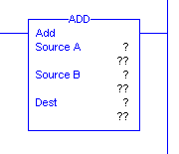
Compute
ADD
When rung conditions are true, the ADD output instruction adds Source A to Source B and stores the result at the Destination tag. Source A and Source B can either tags that contain values or be constant values, however Source A and Source B cannot both be constants. The Destination must be an tag.

Slide 3
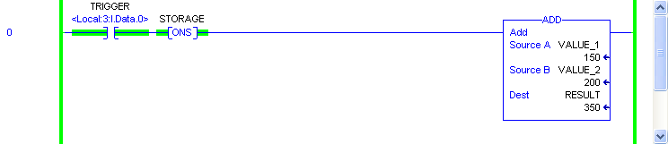
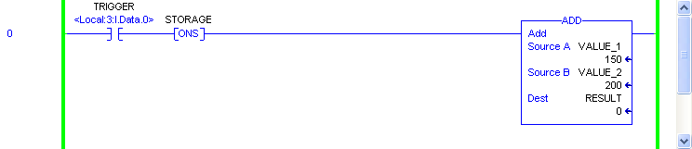
Compute
ADD

Slide 4
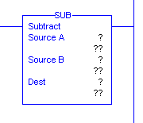
Compute
SUBTRACT
When rung conditions are true, the SUB output instruction subtracts Source B from Source A and stores the result in the Destination tag. Source A and Source B can either tags that contain values or be constant values, however Source A and Source B cannot both be constants. The Destination must be an tag.

Slide 5
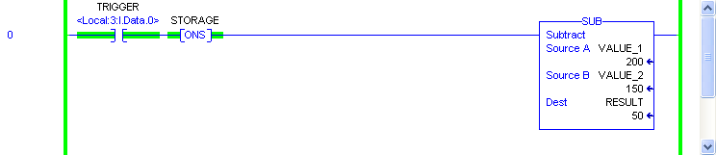
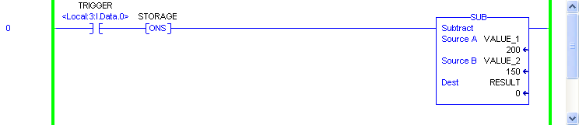
Compute
SUBTRACT

Slide 6
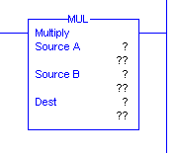
Compute
MULTIPLE
When rung conditions are true, the MUL output instruction multiplies Source A by Source B and stores the result in the Destination. Source A and Source B can either be addresses that contain values or constant values, however Source A and Source B cannot both be constants. The Destination must be an address.

Slide 7
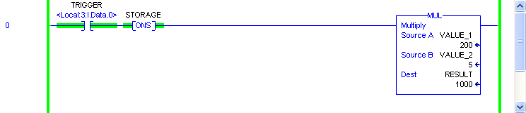
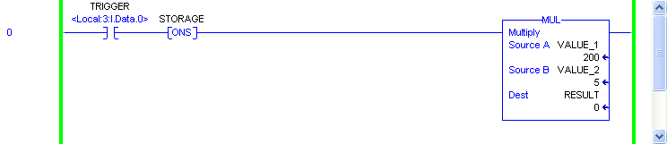
Compute
MULTIPLE

Slide 8
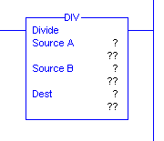
Compute
DIVIDE
When rung conditions are true, the DIV output instruction divides Source A by Source B and stores the result in the Destination tag. Source A and Source B can either tags that contain values or be constant values, however Source A and Source B cannot both be constants. The Destination must be an tag.

Slide 9

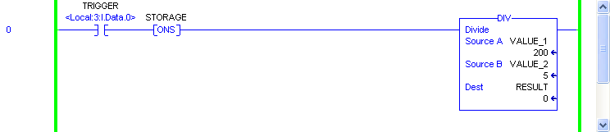
Compute
DIVIDE

Slide 10


Compute
DIVIDE
When the result is a real number (with decimal point) and the destination is an Integer, the result is truncated.

Slide 11
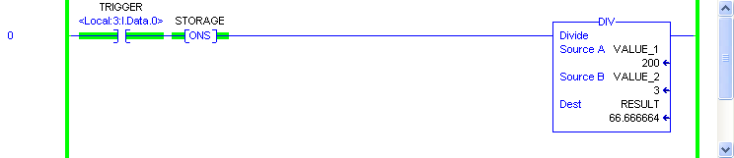
Compute
DIVIDE
Defining the destination as a Real data type the remainder is kept.

Slide 12
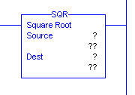
Compute
SQUARE ROOT
When rung conditions are true, this output instruction calculates the square root of the absolute value of the Source and places the rounded result in the Destination.

Slide 13
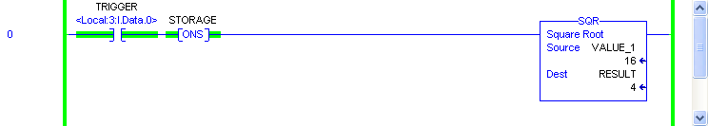
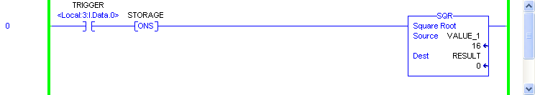
Compute
SQUARE ROOT

Slide 14
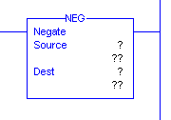
Compute
NEGATE
When rung conditions are true, the NEG instruction changes the sign of the Source and places it in the Destination. The source and destination parameters must be tags.

Slide 15
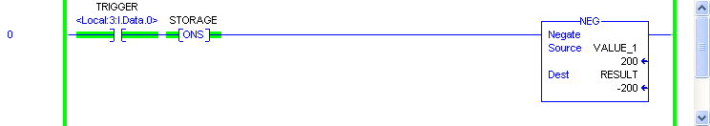
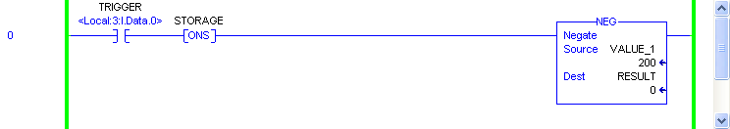
Compute
NEGATE

Slide 16
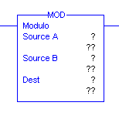
Compute
MODULO
When rung conditions are true, the MOD instruction divides Source A by Source B and places the remainder in the Destination tag. Source A and Source B can either tags that contain values or be constant values, however Source A and Source B cannot both be constants. The Destination must be an tag.

Slide 17
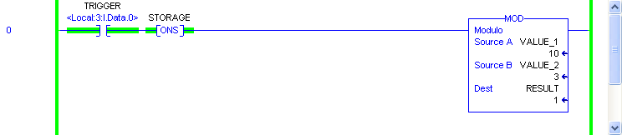
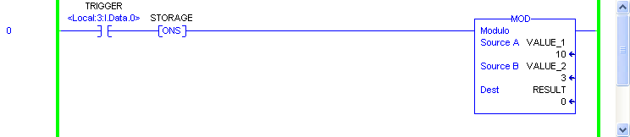
Compute
MODULO
In this example, the division of 10 by 3 leaves a remainder of 1.

Slide 18
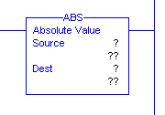
Compute
ABSOLUTE
When rung conditions are true, the ABS instruction takes the absolute value of the Source and places the result in the Destination. The source and destination parameters must be tags.

Slide 19
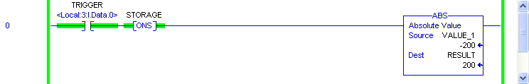
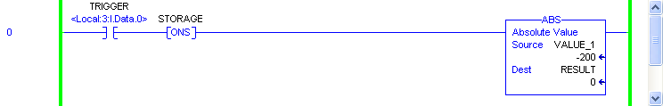
Compute
ABSOLUTE

Slide 20
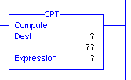
Compute
COMPUTE
When rung conditions are true to this output instruction, the operation residing in the Expression field of this instruction is performed and the result is sent to the Destination.
Expressions - The expression length is unlimited. Instructions that can be used in the Expression include: +, -, *, /, ** (XPY), ACS, ASN, ATN, COS, TAN, SQR, LOG, LN, DEG, RAD, ABS, MOD, TRN, AND, OR, XOR, NOT, FRD, and TOD. The execution of a CPT instruction is longer than a single arithmetic operation and uses more instruction words.

Slide 21
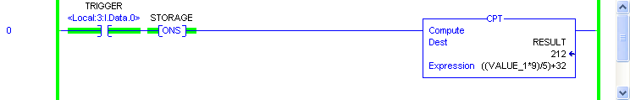
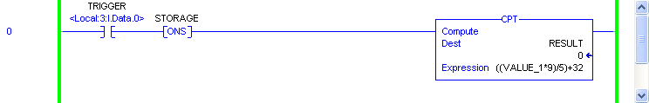
Compute
COMPUTE

Slide 22

Compute
The Compute instruction buttons are in he Compute/Math Tab.

Slide 23
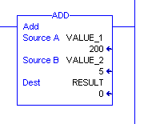
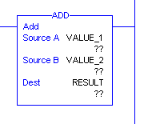
Compute
When the instruction is first entered, there are three sets of question marks.
Three of the question marks are for the tags.
When the rung is verified, the current value at the tag is shown.
The values may be entered in the instruction or the RSLogix 5000 Tag Editor for Monitor.

Slide 24

Other Arithmetic Instructions
LN Calculate the natural log of a number
LOG Calculates the log base 10 of a number
XPY Raise a number (Source A) to the power of a number (Source B)

Slide 25

Other Arithmetic Instructions
SIN Calculate the sine of a number in radians
COS Calculate the cosine of a number in radians
TAN Calculates the tangent of a number in radians
ASN Calculate the arc sine of a number in radians
ACS Calculate the arc cosine of a number in radians
ATN Calculate the arc tangent of a number in radians

Slide 26

Other Arithmetic Instructions
DEG Convert a number (in radians) to degrees
RAD Convert a value (in degrees) to radians
TRN Removes (truncates) the fractional part of the Source and stores the result in the Destination.
There are two BCD conversion buttons which are defined in a separate presentation.

